Slide 1

LYME Disease
Staff Training
Adapted from training developed by Ed Morris, NEZ Ecologist

Slide 2
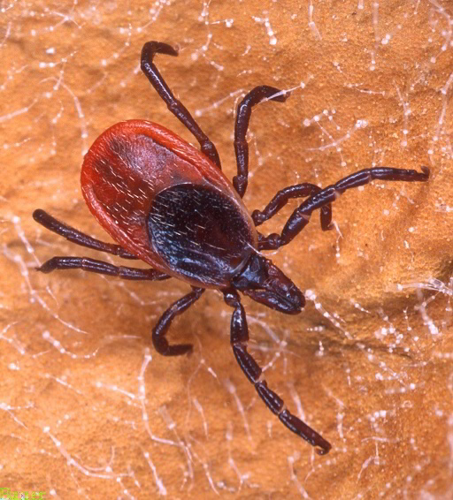
Lyme Disease
Lyme disease is spread by the blacklegged tick (Ixodes scapularis), often referred to as a ‘deer tick.‘
Lyme disease is caused by the bacterium Borrelia burgdorferi and is transmitted to humans through the bite of infected blacklegged ticks.

Slide 3
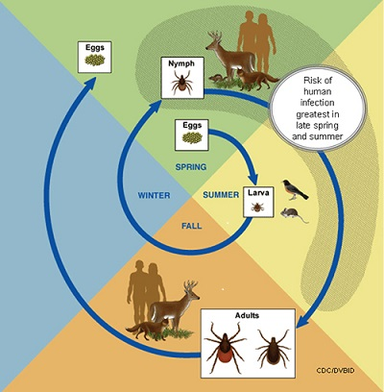
Tick Life Cycle
The stages are the egg, larva, nymph, and adult.
After hatching from eggs, ticks must take a blood meal at each subsequent stage to progress to the next stage. Adult females need the protein from the blood to develop their eggs.
Ticks can feed on mammals, birds, reptiles, and amphibians.
While adult ticks pose a risk, nymphs pose the greatest risk for infection because they are so tiny (less than 2mm) and difficult to see.
Ticks are most active in the summer months, but can be found at any time of the year when the temperature is above freezing.
Content source: Centers for Disease Control and Prevention

Slide 4
How Do I Avoid Ticks?
Wear light-coloured clothing. It makes ticks easier to spot.
Wear closed footwear and socks, and a long sleeved shirt tucked into long pants. Tuck your pants into your socks.
Use a tick repellent that has "DEET" (following the manufacturer's directions). Apply it to your skin and outer clothing. Avoid your eyes and mouth, as well as cuts and scrapes.
If in an area where you might get a tick bite, search your clothes and body well for ticks at least once a day.
Pay special attention to areas such as groin, navel, armpits, scalp and behind ears and knees. Use a mirror to check the back of your body or have someone else check it for you.
Identified risk areas have spread further across Ontario. While the probability is low, it’s possible to encounter an infected tick almost anywhere in Ontario. See Public Health Ontario’s “Lyme disease estimated risk areas map” for more information.

Slide 5
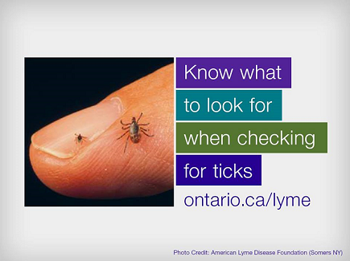
Nymph
Adult

Slide 6
What Do I Do if I Spot a Tick?
Prompt removal of ticks from your skin will help prevent infection, since transmission of Borrelia burgdorferi is unlikely to occur if the tick can be removed within 24 hours of attachment.
Use fine-tipped tweezers or a tick remover tool to grasp the tick as close to the skin's surface as possible.
Pull upward, gently but firmly.
Don't squeeze the body of the tick. Squeezing the body can result in bacteria moving from the tick’s gut to its mouthparts.
Don't put anything on the tick, or try to burn the tick off.
After removing the tick, thoroughly clean the bite area and your hands with rubbing alcohol, or soap and water.
Save the tick alive in a jar or screw top bottle if you can, and take it to your doctor or local health unit. If appropriate, they’ll send the tick to the Public Health Ontario Laboratory for identification and testing.
Tick submissions are used to help determine new areas where blacklegged tick population are being established.
While testing ticks is valuable in ongoing surveillance, it shouldn’t be used to diagnose Lyme. Diagnosis should be based on a health care provider’s clinical judgement.

Slide 7
Signs and Symptoms
Common symptoms of Lyme disease include:
Rash, fever, chills, headache, fatigue, muscle/joint aches; problems with your heartbeat, breathing, balance, short-term memory.
People with Lyme disease often see symptoms after 1-2 weeks. But you can see symptoms as early as 3 days or as long as a month after a tick bite.
The symptom most commonly associated with Lyme disease is an expanding skin rash. If a rash develops, it can begin at the site of the tick bite between three and 30 days after exposure and usually grows in size for several days.
Many people will never get or see the rash because it’s on a area of the body that’s difficult to see.
If there is a rash, it’s advisable to take photos, dated and with a tape measure to determine size later.

Slide 9
Lyme Disease
See a health care provider as early as possible if:
• you have symptoms
• you feel unwell in the weeks following a bite
• you have been in an area where ticks may live and no bite is evident
Tell the health care professional about your tick bite or where you were. If you were bitten and saved the tick, bring it to your medical appointment.
The earlier treatment is received the better. Most cases of Lyme disease can be treated successfully with a few weeks of antibiotics.

Slide 10
For more information…
Ontario Parks Public Health Program - Shawn Telford, shawn.telford@ontario.ca or 705-755-1716
Local Public Health Unit staff
Visit ontario.ca/Lyme

